Slide 1
Project Presentation of CO-OP Project at Industry (Module-2) (22CS421)
On
Cloud-Based Industrial Digital Twin Platform for IoT-Integrated 3D Asset Monitoring and Predictive Analytics
Sparsh Mittal (2210990865) Payal (2210992037) Arshpreet Singh (2210991370)
Supervised By
Dr. S.B. Goyal
Department of Computer Science and Engineering,
Chitkara University, Punjab

Slide 2
Introduction
Industrial systems require continuous monitoring for reliability and efficiency
Traditional systems lack integration between CAD models and sensor data
Visualization is limited to numerical values, reducing clarity
Digital Twin bridges physical machines with virtual 3D models
Enables real-time monitoring, analysis, and predictive decision-making
2

Slide 3
Problem Statement
Existing systems are fragmented and non-centralized
CAD data and IoT sensor data are stored separately
Lack of real-time synchronization between physical and digital systems
Monitoring relies on numbers instead of visual insights
Difficult to detect faults early and optimize maintenance
3

Slide 4
Problem Statement
Existing systems are fragmented and non-centralized
CAD data and IoT sensor data are stored separately
Lack of real-time synchronization between physical and digital systems
Monitoring relies on numbers instead of visual insights
Difficult to detect faults early and optimize maintenance
4

Slide 5
Objective
Develop a cloud-based centralized Digital Twin platform
Achieve real-time synchronization (latency: 1–2 seconds)
Ensure high mapping accuracy (90–95%)
Integrate IoT sensor data with 3D CAD models
Enable predictive analytics and improved decision-making
5

Slide 6
Proposed System
Inputs: CAD 3D models + IoT sensor data (temperature, vibration, acceleration)
Processing: Data ingestion, mapping, synchronization, and analytics
Core: Real-time synchronization engine linking sensors to 3D components
Output: Interactive 3D visualization with performance insights
Provides accurate representation of machine behaviour in real time
6

Slide 7
Methodology
CAD models are created and optimized into lightweight 3D formats
IoT sensors collect real-time machine data at defined sampling rates
Sensor data is mapped to specific components of 3D models
Data is processed for KPIs, trends, and machine health metrics
Dashboard displays synchronized digital twin and analytics
7

Slide 8
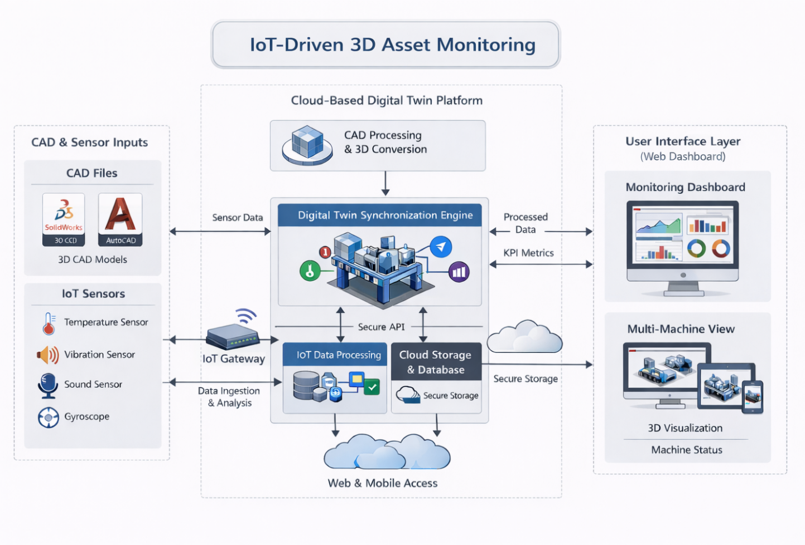
Methodology
8

Slide 9
Tools & Technologies
CAD Tools: SolidWorks, AutoCAD for machine design
3D Optimization: Blender for lightweight rendering
Cloud Platform: AWS for storage, scalability, and processing
Backend: APIs for data handling and synchronization
Frontend: Web dashboard for visualization and interaction
IoT Sensors: Measure temperature (1/sec), vibration (10–50/sec), acceleration
9

Slide 10
Key Features & Proposed Results
Real-time 3D digital twin with IoT data integration
Sensor-to-component mapping with 90–95% accuracy
Synchronization latency maintained at 1–2 seconds
20–30% faster anomaly detection compared to traditional systems
15–20% improvement in maintenance efficiency
Historical data analysis for trend identification and prediction
10

Slide 11
Conclusion & Future Scope
Provides efficient real-time monitoring and improved visualization
Reduces downtime and maintenance costs through predictive insights
Enhances operational decision-making with data-driven analytics
Future scope includes:
AI/ML-based predictive maintenance
AR/VR-based immersive visualization Advanced time-series data storage systems
Multi-machine integrated monitoring platform
11

Slide 12
Thank You
12

